Slide 1



TRIPLE J

Slide 2






OUTLINE
Proposal Review
Use Case
Requirements Class Model
Constraint & Object Model Review

Slide 3







We Propose:
TutorJA
Supplimenting the Traditional Learning Experience

Slide 4




EDUCATION FOR THE FUTURE
Bridging the gap through technology

Slide 5



Connecting
Who need:
Face-to-Face One-on-one Tutoring
Face-to-Face Small Group Tutoring
Online One-on-one Tutoring
Students
(K3-Grade11)
Online Small Group Tutoring
Tutors

Slide 6










HOW:
mode of delivery
special need
location
grade
subject
Parents sign up to get educational services for their child/children
Specifying their preferences
Select a Tutor's service
Request Enrollment

Slide 7




Use Case Model

Slide 8
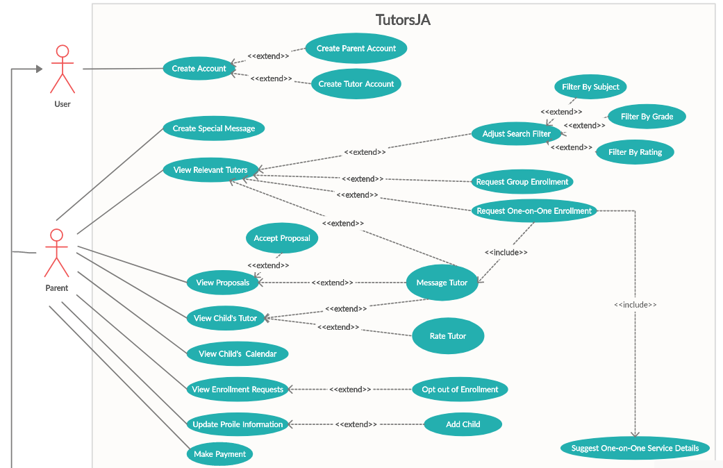

Slide 9
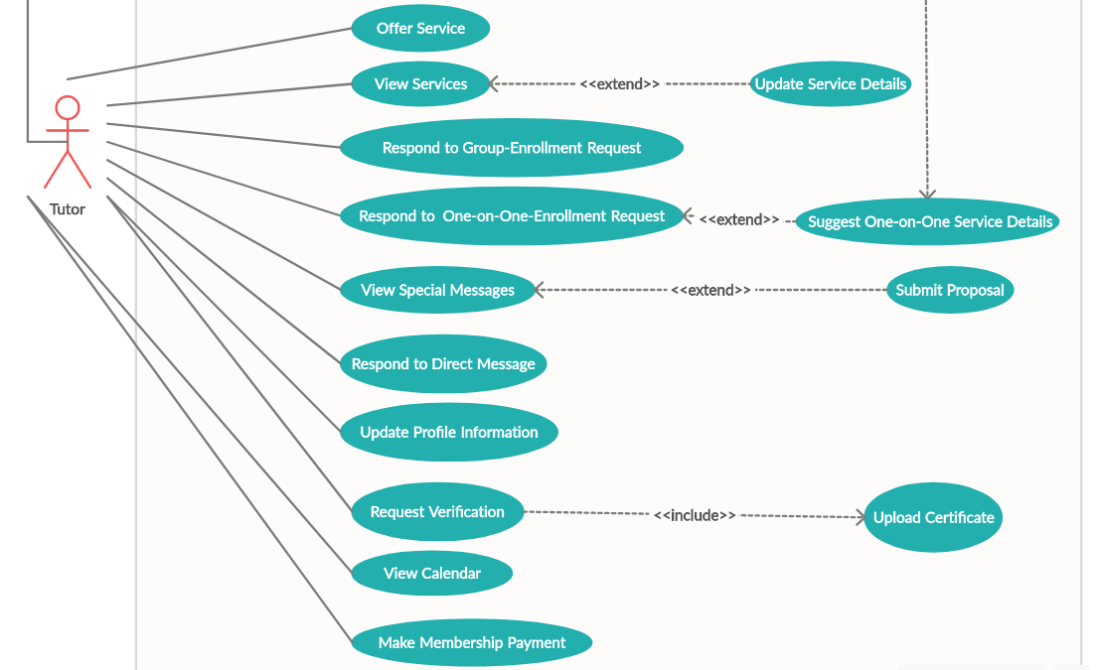

Slide 10



REQUIREMENT CLASS MODEL

Slide 11
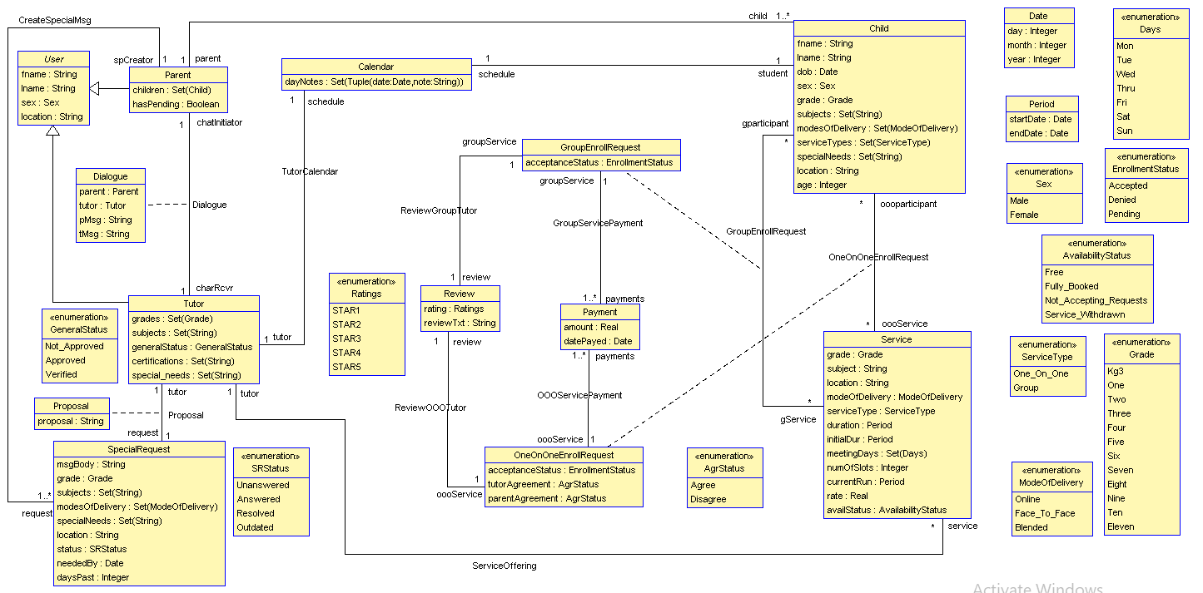

Slide 12

CONSTRAINTS
&
OBJECT MODEL REVIEW

Slide 13


Constraints Overview
If the mode of delivery is online then there is no meet location
A child must have a minimum age of 5 and a child must be below 19 years of age
inv :
self.modeOfDelivery = ModeOfDelivery::Online implies self.location = null
end
context Child inv ageFiveToNineteen:
self.age>= 5 and self.age < 19
end
context Child inv ageFiveToNineteen:
self.age>= 5 and self.age < 19
end

Slide 14
Constraints Overview
Only Tutors who are approved may offer service
A parent may review a tutor only after rating them
context Tutor inv mustBeApproved:
self.service->size()>0 implies self.generalStatus = GeneralStatus::Approved
end
context Parent inv mustRateThenReview:
self.rate = null implies self.review = null
end

Slide 15
Constraints Overview
A one-on-one enrollment request must be for a service with type "One-on-One"
A group enrollment request must be for a service with type "Group"
inv :
oooService.serviceType = ServiceType::One_On_One
end
inv :
self.gService.serviceType = ServiceType::Group
end

Slide 16


A child must have a minimum age of 5 and a child must be below 19 years of age

Slide 17
Only Tutors who are approved may offer service

Slide 18
If the mode of delivery is online then there is no meet location

Slide 19
A parent may review a tutor only after rating them

Slide 20
A one-on-one enrollment request must be for a service with type "One-on-One"

Slide 21
A group enrollment request must be for a service with type "Group"

Slide 22





